Slide 1
BASIC excel add-ins with office js apis
Marisa Mahawanchai

Slide 2
outline
Content Add-ins
Excel Object Model and Async Programming
Create new project

Slide 3
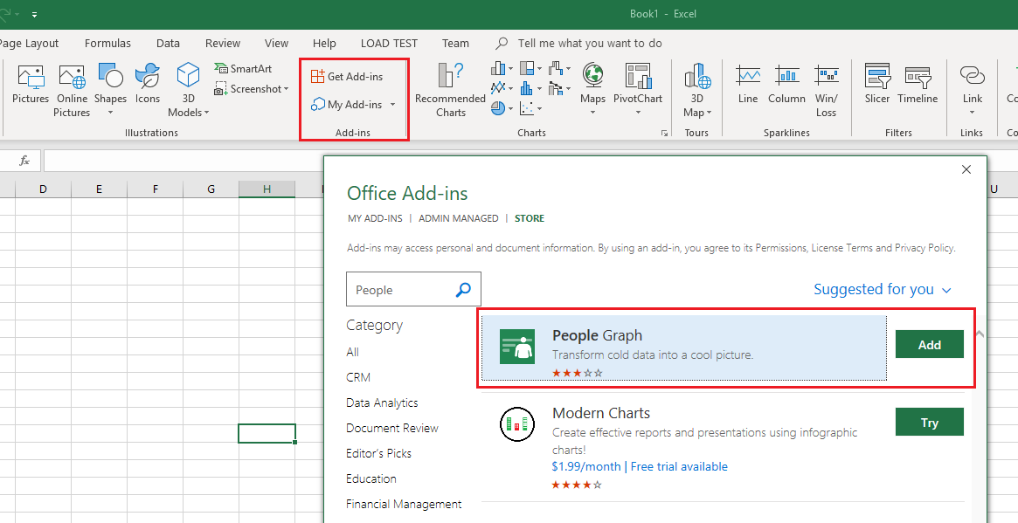
Content Add-ins

Slide 4
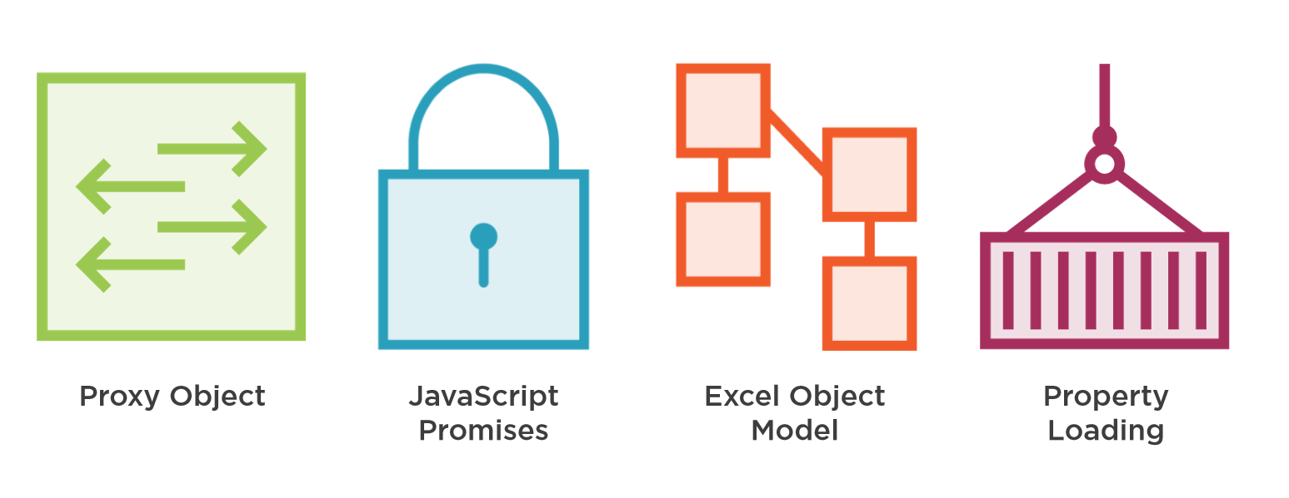
Excel Object Model and Async Programming

Slide 5
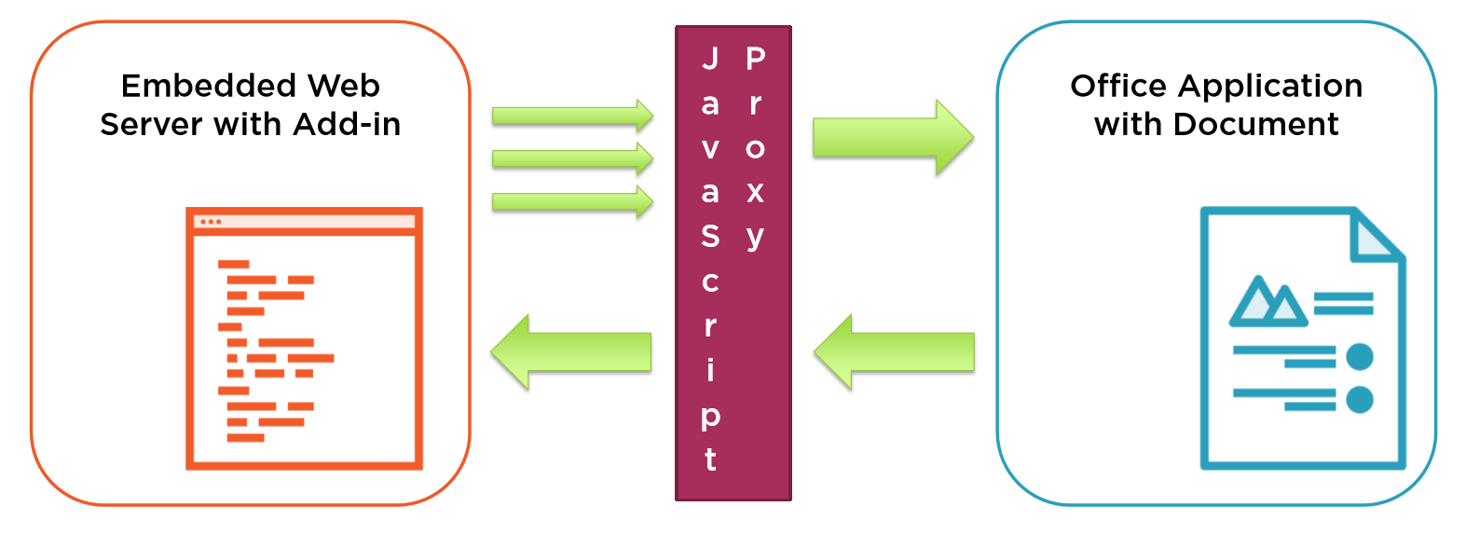
> Proxy object

Slide 6
> Proxy object
function demoProxyObject() {
Excel.run(function (ctx) {
var cws = ctx.workbook.worksheets.getActiveWorksheet();
var range = cws.getRange("A1");
range.values = "New Text added to A1 range";
var range2 = cws.getRange("A2");
range2.values = "Something else";
ctx.sync();
});
}

Slide 7
> JavaScript promises
function demoJavaScriptPromises() {
Excel.run(function (ctx) {//Start with the context
var cws = ctx.workbook.worksheets.getActiveWorksheet();
var range = cws.getRange("A1:A2");
var rangeSum = cws.getRange("A3");
ctx.load(range);
return ctx.sync()
.then(function () {
if (range.values[0] === "replace") {
range.values = 10; //Set all values to 10
rangeSum.formulas = "SUM(A1:A2)";
}
ctx.load(rangeSum);
return ctx.sync();
})
.then(function () {
if (rangeSum.values === 20)
range.values = 20; // Set all values to 20
return ctx.sync();
})
;
}).catch(function (error) {
showNotification(error.code + ':' + error.name, error.message);
}); //End Excel.run
} //End function demoJavaScriptPromises

Slide 8
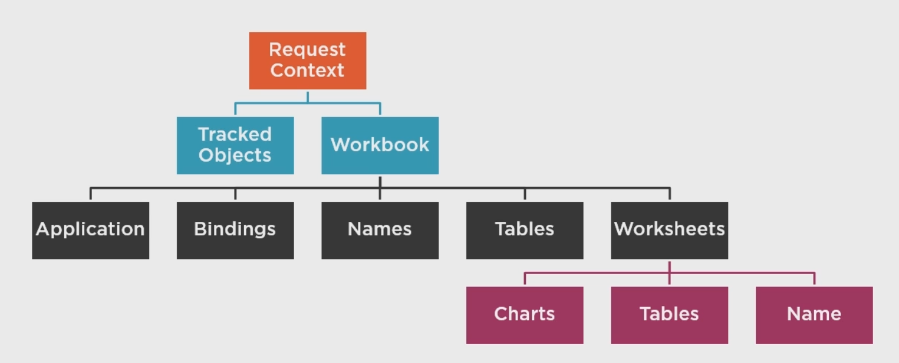
> Excel object model

Slide 9
> Excel object model
function demoObjectModel() {
Excel.run(function (ctx) {
ctx.workbook.worksheets.load('name'); // Load the worksheets names
return ctx.sync()
.then(function () {
// Read the sheet names
var sheetNames = [];
var sheet;
for (var sheetIndex in ctx.workbook.worksheets.items) {
sheet = ctx.workbook.worksheets.items[sheetIndex];
sheetNames.push(sheet.name);
}
// Write to a range on each sheet
for (var sheetIndex2 in ctx.workbook.worksheets.items) {
sheet = ctx.workbook.worksheets.items[sheetIndex2];
var a1Range = sheet.getRange("A1");
a1Range.values = sheetNames.join();
}
var cws = ctx.workbook.worksheets.getActiveWorksheet();
var currentRange = cws.getRange("A1");
ctx.load(currentRange);
return ctx.sync();
})
})
.catch(function (error) {
showNotification(error.code + ':' + error.name, error.message);
});
} //End function demoObjectModel

Slide 10
Create new project

Slide 11
Thank you!

